Slide 1
CYBER CRIME ANALYSIS
DATA BREACH

Slide 2
ABSTRACT
Cyber crime is the major problem in today’s world.Also,cyber criminals are increasing day by day.
We have a locker to protect our money and physical properties, but we do not have safty systems to protect the data which is most confidential to us.
Anywhere and anyone in the world have a possibility to steel our data by knowing our basic details.
Every year, average of 1 billion of data has been stoled.
These data’s include hospital details, banking details, social media details,work details and etc.
The sector in which data lost has been happening each year,mode of hacking and total no.of.records has been lost in each year and the companies which are failed to maintain the data confidentiality has been visualed in this presentation.
So by observing the visuals we can say in which sectors the datas have been majorly breached and also we can conclud that our data is not protected completely.

Slide 3
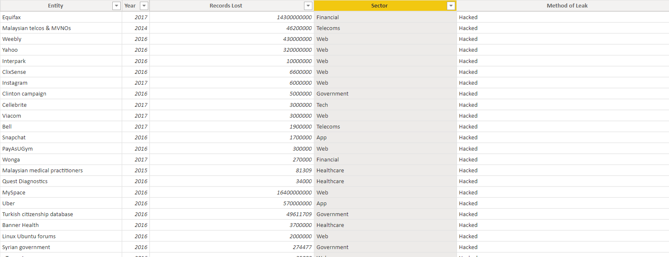

Slide 4
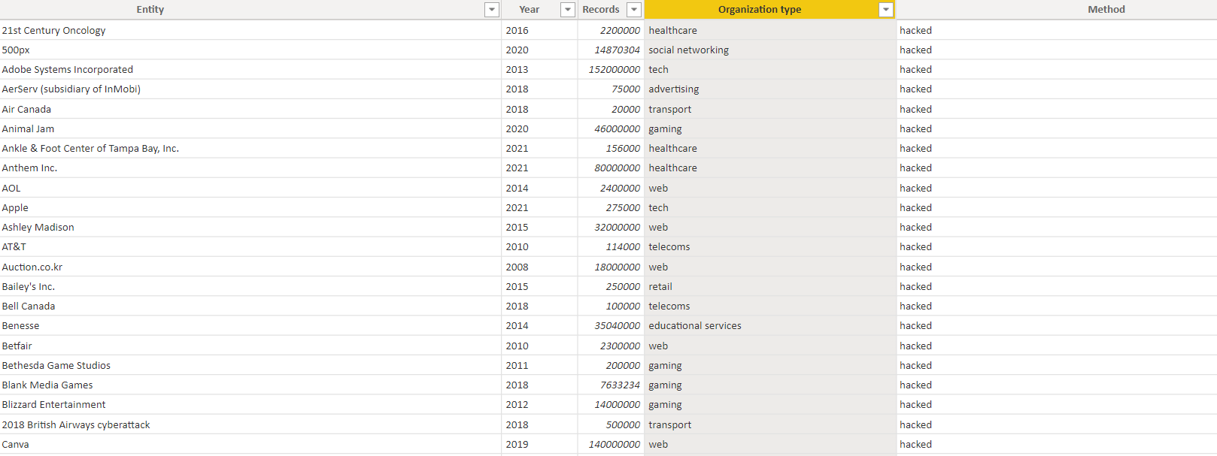

Slide 5
DESCRIPTION
This dataset has more than 3000 rows.
And it has more than 25 columns.
This sheet has many attributes such as Sector name, Year, Records lost, Organization, Organization type, Method of hacked etc.
From this dataset we can infer total.no.of data lost, company, company type etc.
This Dataset shows all Sector name, Year, Records lost, Organization, Organization type, Method of hacked etc.
We can infer the data lost information by using this visual.

Slide 6
ATTRIBUTES
Organization – Organization name such as google etc.
Organization type –such as website,application etc
Method of hacked – SQL Injection, DOS attack
Banking Relationship – whether it is retail or commercial or institutional.
Loss of data – The data which had been lost

Slide 7
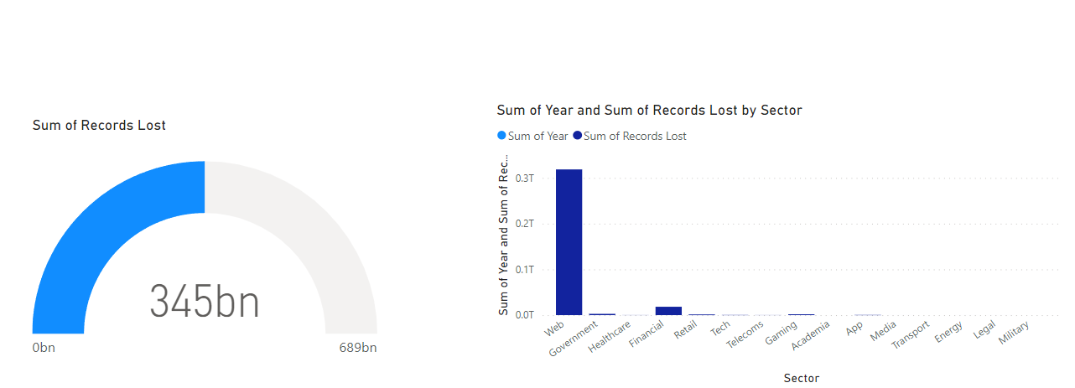

Slide 8
Gauge Chart:
Create a Gauge card.
And this card shows the amount of data lost.
The data lost average of 1Billion.

Slide 9
Clustered Column Chart:
Create a Clustered Column Chart.
From this we can know the data lost.
Data lost level are high, mid and low.
Based on the data lost level, the visuals changes.

Slide 10
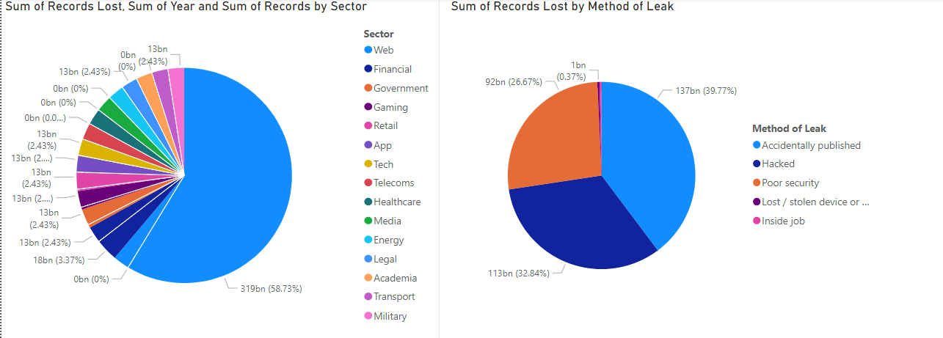

Slide 11
Pie Chart:
Create a Pie chart
This chart shows the all data lost,sectors,organization.
In this chart the data lost by the organization is visualed..

Slide 12
Stacked Column Chart:
Create a Stacked Column Chart.
This chart shows the year of data lost.
The estimated data lost of all the client’s is more

Slide 13
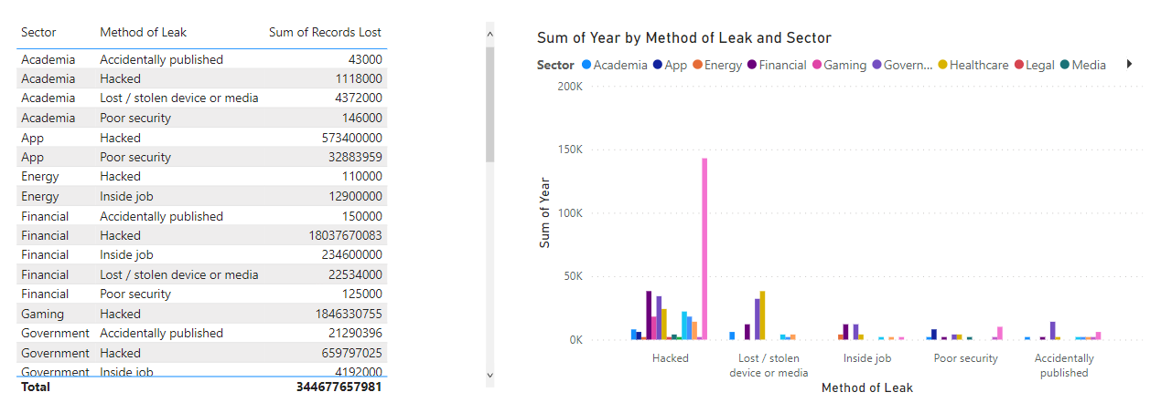

Slide 14
Table Chart:
Create a Table Chart.
By using this table chart, we can infer the data lost, year and Organization type of all the client’s

Slide 15
CARDS
TABLE CHART
In this visual, I have created a card and it shows the total data lost
The total data lost is is 886 B.
In this visual, I have created a table chart and it shows the estimated data lostof the clients with their respective sectors
The total estimated data lostof all clients is 51,39,15,102.28

